Slide 1

Hangman Game
By: Zachary Venuto

Slide 2
Introduction:
I wanted to create a traditional game of hangman for quick, easy fun.
This application is simple to use and understand making it fun for all ages.

Slide 3
Features:
Select difficulty drop box.
Allows players to select a difficulty (Easy, Medium, Hard) which will change up their gameplay.
Input text field which allows players to input a letter guess.
Underscores to display non-guessed letters that are replaced by correctly guessed letters.
Incorrect guesses are kept track of and shown to the player.
The amount of remaining guesses are kept track of and shown to the player.
Win/loss message that is shared depending on whether or not the player won their game.
Replayability
The system will select a new, different random word to randomize the game every time.

Slide 4
Biggest Challenge
JavaFX was my biggest challenge. As I’ve never used this before, it was definitely a struggle to get it working. I had a lot of errors with this GUI not opening, which obviously caused frustration.
The biggest thing that helped was practice. For example, the ShoppingCart assignment where we had to create a GUI to keep track of our shopping cart and prices helped me understand JavaFX a lot.

Slide 5

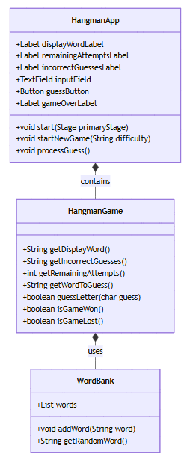
UML Diagram
HangmanApp consists of all the code for the JavaFX GUI. It is the reason the application is able to open as a graphical interface.
HangmanGame consists of all the code to get the application to actually work and be playable
WordBank consists of all the words that could be randomly selected to be playable in the game. This class also breaks up the words between easy, medium, and hard.

Slide 6
HangmanApp Class
+Label displayWordLabel: Displays the underscores and correctly guessed letters.
+Label remainingAttemptsLabel: Displays the number of remaining attempts the player has.
+Label incorrectGuessesLabel: Displays the incorrect guesses that the player has already guessed.
+TextField inputField: Displays an interactable text field that allows the player to input their letter guess.
+Button guessButton: Displays an interactable button that allows the player to submit their letter guess.
+Label gameOverLabel: Displays a game over message when the player wins or loses.
+void start(Stage primaryStage): Initializes the GUI
+void startNewGame(String difficulty): Starts a new game based on the difficulty level the player selected.
+void processGuess(): Processes the player's letter guess and updates the GUI based on whether the guess was correct or incorrect.

Slide 7
HangmanGame Class:
+String getDisplayWord(): Keeps track of the word with underscores and the correctly guessed letters.
+String getIncorrectGuesses(): Keeps track of the incorrect guesses the player made.
+int getRemainingAttemtps(): Keeps track of the amount of remaining guess attempts.
+String getWordToGuess(): Keeps track of the word that needs to be guessed.
+boolean guessLetter(char guess): Checks if the guessed letter the player makes is in the word.
+boolean isGameWon(): Keeps track if the player won the game.
+boolean isGameLost(): Keeps track if the player lost the game.

Slide 8
WordBank Class:
+List words: Provides a list of words that the application randomly selects out of for the game.
+void getRandomWord(): Chooses a random word from the word pool for the game.

